Slide 1
Research Communication Skills
Reading Research Papers

Slide 2
Review - A day of a researcher
What activities do researchers do every day?

Slide 3
How much time does a researcher spend reading papers?
“A typical researcher will likely spend hundreds of hours every year reading papers. “
  Keshav, S. (2007). How to read a paper. ACM SIGCOMM Computer Communication Review, 37(3), 83–84.

Slide 4
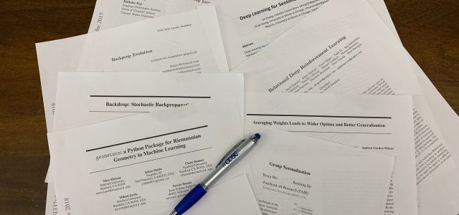
Have you ever read a research paper?

Slide 5
Intended Learning Outcomes
By the end of this lesson you will be able to:
  distinguish between different paper reading strategies
  figure out how to read the paper for different purposes
  read the paper quickly
  develop understanding of the paper

Slide 6
Did you (try to) read the papers you found for your homework (or other papers)?

Slide 7
Do you know how to read research papers?

Slide 8
What are YOUR difficulties in reading papers?

Slide 9
Reading a research paper is different than other reading!
10 pages of news: < 10 minutes
10 pages of fiction: < 20 minutes
10 pages in a textbook: < 30 minutes
10 page research paper: 20 minutes – several hours!

Slide 10
Is paper reading important?
Or can we just work on our own ideas without worrying about what other researchers have done?

Slide 11
Recall one of the definitions of research
Research - the activity of a diligent and systematic inquiry or investigation in an area, with the objective of discovering or revising facts, theories, applications etc.

Slide 12
Recall Research Goals
Deepen understanding of a topic
Contribute to the community’s understanding of a topic
Discover and disseminate new knowledge

Slide 13
Recall Research Process
Realize there is a problem
Look to see if anyone has solved it
Develop a plan to solve it
Solve it
Evaluate your solution
Disseminate your solution

Slide 14
Reading research papers
Reading research papers is important task during research, especially in the early stages of the process
Before we discuss reading research papers in details, let’s do some quick example

Slide 15
Reading for comprehension - activity
https://www.chinasichuanfood.com/chongqing-noodles/
….. How quickly can we answer the following questions?
  Is this a recipe for a dessert or a breakfast meal?
  How much noodles do we need?
  How many calories per serving?

Slide 16
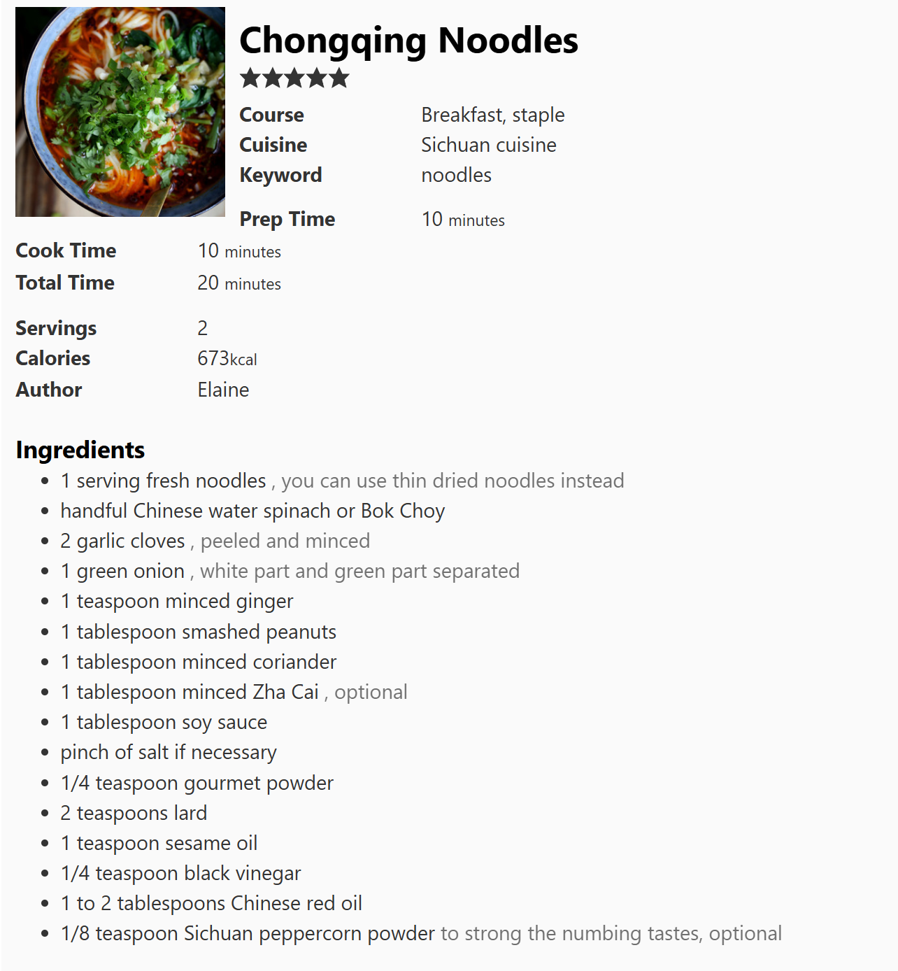
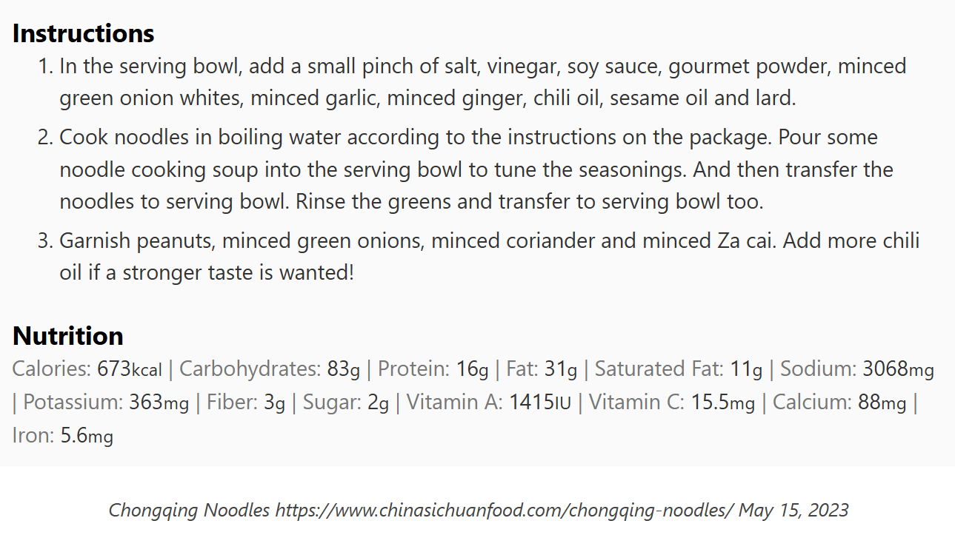

Slide 17
Reading for comprehension - activity
Research Process
  Realize there is a problem
  Look to see if anyone has solved it
  Develop a plan to solve it
  Solve it
  Evaluate your solution
  Disseminate your solution
Find the section in the paper I have sent to our WeChat which discusses evaluation of the proposed solution.

Slide 18
Can we answer some of the questions without reading the text in detail?
  But…. Can you copy the process of making this dish now?
  Can you reproduce the experiments described in the research paper?
So… Does it make sense to read so quickly if at the end we do not know all the details?

Slide 19
Different purposes to read the paper (1)
You need to review a paper for a conference or a class
You want to be up-to-date on current research in your field
You want to learn about a new field
  Learn about a sub-field
  Learn about another discipline that may offer solutions to a problem
You want to find a problem to work on

Slide 20
Different purposes to read the paper (2)
You want to write a literature survey
You want to replicate the results described in the paper (or extend them)
The paper provides you with useful data
The paper gives you « pre-digested » thoughts
The paper teaches you how to write

Slide 21
Recall our example earlier
Why could you answer those questions faster than you estimated?

Slide 22
Standardization

Slide 23
Reading a Scientific Article
To comprehend the article you must understand the main points of each major article section.

Slide 24
What are the common sections in a research article?

Slide 25
Sections of the Research Paper
Are the sections in any of your papers different than those listed here?
Title
Introduction
Abstract
State of the Art/Literature Review/Related Works
Problem Motivation
Solution/Proposed Approach
Proof/Evaluation/Discussion
Conclusion/Summary/
Future Work
Acknowledgments
References
These items do not necessarily have their own section and some of them might be combined, e.g., state of the art and problem motivation.
Survey papers will have some differences as well – we will discuss it soon

Slide 26
Research paper structure
Most journals use a conventional IMRD structure:
  An abstract followed by
    Introduction
    Methods
    Results
    Discussion

Slide 27
Abstract
A paper begins with a short Summary or Abstract. Generally, it gives a brief background to the topic; describes concisely the major findings of the paper; and relates these findings to the field of study. Abstracts generally include information from all of the paper’s major sections.
Many researchers always read the abstract before reading the paper. The abstract gives an overview of all the article’s sections and provides a short introduction to the entire article.

Slide 28
Abstract
Abstracts usually contain four kinds of information:
  purpose or rationale of study (why they did it)
  methodology (how they did it)
  results (what they found)
  conclusion (what it means)

Slide 29
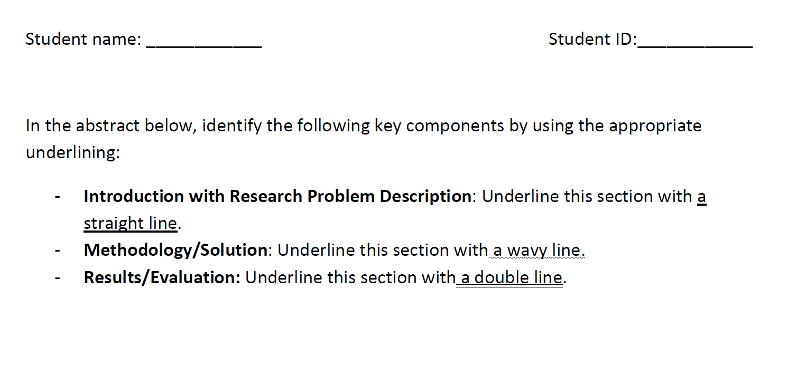
Exercise 1

Slide 30
EFFECT OF CLIMATE FLUCTUATIONS ON LONG-TERM VEGETATION
DYNAMICS IN CAROLINA BAY WETLANDS
Chrissa L. Stroh1,4, Diane De Steven2, and Glenn R. Guntenspergen3
1Master of Environmental Studies Program
The College of Charleston
Charleston, South Carolina, USA 29424
2USDA Forest Service–Southern Research Station
Center for Bottomland Hardwoods Research
Stoneville, Mississippi, USA 38776
3U.S. Geological Survey–Patuxent Wildlife Research Center
Laurel, Maryland, USA 20706
E-mail: glenn_gtenspergen@usgs.gov
Abstract: Carolina bays and similar depression wetlands of the U.S. Southeastern Coastal Plain have
hydrologic regimes that are driven primarily by rainfall. Therefore, climate fluctuations such as drought
cycles have the potential to shape lonterm vegetation dynamics. Models suggest two potential longterm
responses to hydrologic fluctuations, either cyclic change maintaining open emergent vegetation, or
directional succession toward forest vegetation. In seven Carolina bay wetlands on the Savannah River
Site, South Carolina, we assessed hydrologic variation and vegetation response over a 15-year period
spanning two drought and reinundation cycles. Changes in pond stage (water depth) were monitored biweekly
to monthly each year from 1989–2003. Vegetation composition was sampled in three years (1989,
1993, and 2003) and analyzed in relation to changes in hydrologic conditions. Multi-year droughts
occurred prior to the 1989 and 2003 sampling years, whereas 1993 coincided with a wet period. Wetland
plant species generally maintained dominance after both wet and dry conditions, but the abundances of
different plant growth forms and species indicator categories shifted over the 15-year period. Decreased
hydroperiods and water depths during droughts led to increased cover of grass, upland, and woody
species, particularly at he shallower wetland margins. Conversely, reinundation and longer hydroperiods
resulted in expansion of aquatic and emergent species and reduced the cover of flood-intolerant woody
and upland species. These semi-permanent Upper Coastal Plain bays generally exhibited cyclic vegetation
dynamics in response to climate fluctuation, with wet periods favoring dominance by herbaceous species.
Large basin morphology and deep ponding, paired with surrounding upland forest dominated by floodintolerant
pines, were features contributing to persistence of herbaceous vegetation. Drought cycles may
promote directional succession to forest in bays that are smaller, shallower, or colonized by floodtolerant
hardwoods.
Key Words: depressional wetlands, drought cycles, hydrologic regime, succession
INTRODUCTION
The hydrologic regimes of depressional wetlands
determine their ecological character. Because depression
hydrology is driven mainly by rainfall and
evapotranspiration, these
Semisupervised Deep Reinforcement Learning in Support of IoT and Smart City Services
Mehdi Mohammadi ; Ala Al-Fuqaha ; Mohsen Guizani ; Jun-Seok Oh
Abstract: Smart services are an important element of the smart cities and the Internet of Things (IoT) ecosystems where the intelligence behind the services is obtained and improved through the sensory data. Providing a large amount of training data is not always feasible; therefore, we need to consider alternative ways that incorporate unlabeled data as well. In recent years, deep reinforcement learning (DRL) has gained great success in several application domains. It is an applicable method for IoT and smart city scenarios where auto-generated data can be partially labeled by users' feedback for training purposes. In this paper, we propose a semisupervised DRL model that fits smart city applications as it consumes both labeled and unlabeled data to improve the performance and accuracy of the learning agent. The model utilizes variational autoencoders as the inference engine for generalizing optimal policies. To the best of our knowledge, the proposed model is the first investigation that extends DRL to the semisupervised paradigm. As a case study of smart city applications, we focus on smart buildings and apply the proposed model to the problem of indoor localization based on Bluetooth low energy signal strength. Indoor localization is the main component of smart city services since people spend significant time in indoor environments. Our model learns the best action policies that lead to a close estimation of the target locations with an improvement of 23% in terms of distance to the target and at least 67% more received rewards compared to the supervised DRL model.
In the abstract above, the introduction is abstracted in green, solution in red, evaluation in purple. The proportion of the abstract allocated to each section will vary according to the article.
Read this abstract. Do you have a fair understanding of the problem and what was done to address it? You may want to do a little internet searching or other research to fully understand the abstract.

Slide 31
Group work task 1

Slide 32
Introduction
Introductions serve two purposes
  Creating readers’ interest in the subject
  Providing them with enough information to understand the article

Slide 33

Introduction
Broad: what is known about the topic
Generally, introductions lead readers
  from broad information
  to more specific information
  to a focal point
Specific: what is not known
Focal point: what question the authors asked and answered

Slide 34
Introduction
Authors describe previous work that led to current understanding of the topic
Authors situate their work within the field

Slide 35
Sections of the Research Paper
Title
Introduction
Abstract
State of the Art/Literature Review/Related Works
Problem Motivation
Solution/Proposed Approach
Proof/Evaluation/Discussion
Conclusion/Summary/
Future Work
Acknowledgments
References
More details on the purpose and content of the remaining sections will be given soon

Slide 36
Figures and Tables
Find examples of Figures and Tables in a paper

Slide 37
Reading Figures (Drawings)
Look at the entire figure
Read the labels
Read any keys/legends, captions or explanations
Look for the starting point and the flow of the diagram (arrows can often serve as a visual cue)

Slide 38
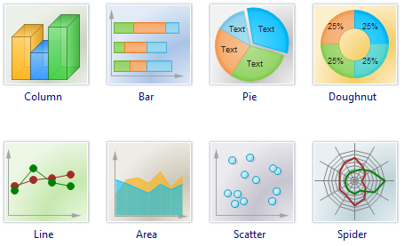
Reading Figures (Graphs)
The most common chart types used in journals include
  Column -- Each column is proportional to the value it represents

Slide 39
Reading Figures (Graphs)
The most common chart types used in journals include
  Bar -- Each bar is proportional to the value it represents

Slide 40
Reading Figures (Graphs)
The most common chart types used in journals include
  Pie -- Each "slice" represents the proportion of one component to another

Slide 41
Reading Figures (Graphs)
The most common chart types used in journals include
  Line - shows how the value is changing

Slide 42
Reading Figures (Graphs)
The most common chart types used in journals include
  Scatter -- Each dot is relational to all other dots and can show frequency

Slide 43
Reading Figures (Graphs)
Other chart types
  Doughnut, area, spider, ….

Slide 44
Reading Tables
Look at the entire table
Read the labels (title, column heads and stubs, etc)
Read any keys/legends, captions or notes/explanations
Look for a narrative explanation of the table in the body of the text.

Slide 45
Understanding the different parts of a scientific article can help the reader to understand the material
https://guides.libraries.indiana.edu/c.php?g=992698&p=7182643

Slide 46
Title
The title of the article can give the reader a lot of information about its contents, such as the topic, major ideas, etc.

Slide 47
Abstract
Abstracts help to summarize the article and give the reader a preview of the material they are about to read.

Slide 48
Introduction
The introduction will provide an explanation to the purpose of the article. Usually, this will also include other relevant research or data that can help the reader understand the material in the article.
The research question will be presented in this part of the article and should help the reader to understand what the author expected to find or understand.
When reading the introduction it is best to keep a few questions in mind:
  What is the article's purpose being stated in the introduction?
  Why would this article be of interest to experts in the field?
  What is already known, or not known, about this topic?
  What specifically is the hypothesis? If one is not given, what are the expectations of the author?
Having these questions in mind when reading the introduction can help the reader gain an understanding of the article as a whole. A good research article will answer these questions in the introduction and be consistent with their explanation throughout the rest of the article.

Slide 49
Method
The method section of a scientific paper guides the reader through the approach taken with the research.
This section answers why the researcher chose specific procedures and justifies the design of the experiment.
When reading the methods section, keep these questions in mind:
  What are the specific methods used by the researcher?
  Does the researcher provide a coherent and viable plan for their experiment?
  Has the author missed any variables that could affect the results of their findings?
  How do the methods in this article compare with similar articles?

Slide 50
Results
The results are the findings from the experiment. It is important that the results section simply states the outcome of the experiment or research, without interpretation. Many times, this section will include numerical or statistical evidence, along with graphs, charts, or other figures.
When reading the results sections of an article, keep these questions in mind:
  How do the results relate to the hypothesis stated in the introduction?
    Ex: they are correlated and support the hypothesis, they contradict they hypothesis, ect.
  If there are differences from the hypothesis, what differences did the researcher find?
  Are the findings described in an unbiased way?

Slide 51
Discussion
The discussion summarizes the finding from the experiment or research. This section highlights the interpretation from the data, new discoveries, or other relevant information that have come from the article. The author will propose new research or insights into the problem undertaken in the introduction.
When reading the discussion, keep these questions in mind:
  Is there new information presented that wasn't known before?
  Is the researcher unbiased in their presentation?
  What are the real-world implication of the findings?
    Ex: More research needs to be done, the findings show a solution to a known problem, etc.
  What suggestions are made about future research? If no suggestions are made, should there be?

Slide 52
Conclusion
The conclusion points out the important findings from the experiment or research.
Occasionally, it will incorporated into the discussion section of the paper.

Slide 53
General Tips
Fully comprehending a scientific article will most likely take more than one read. Don't be discouraged if you don't understand everything the first time, reading scientific papers is a skill that is developed with practice.
Start with the broad and then to the specific. Begin by understanding the topic of the article before trying to dig through all the fine points the author is making.
Always read the tables, charts, and figures. These will give a visual clue to the methods and results sections of the paper and help you to understand the data. The author put these in the paper for a reason, don't dismiss their importance.
Don't be afraid to ask questions or look up definitions. If you do not understand a term or concept, do not be afraid to ask for help or look up an explanation.

